Slide 1
Investments in Technology
Khalil Hamdani
Arab High-Level Forum on Sustainable Development
Bahrain, 6 May 2015

Slide 2
Investing in the SDGs
The SDGs will require significant investment, well beyond current levels
The investments will be needed in areas traditionally earmarked for the public sector and development aid
A tripling of current efforts is needed in developing countries
An even greater increase is needed in the Arab region

Slide 3
Bridging the gap
A scaling up of current efforts will not bridge the financing gap without:
New technologies to reach larger populations at lower cost and smaller environmental footprint
New business models to encourage private investments in social sectors
Partnerships with foreign investors
Greater role for non-governmental organizations
New developmental roles for the state

Slide 4
Public-Private investment
The private sector must contribute more
However, public investment, and ODA, must also rise in order to leverage greater private sector participation
Governments should invest in people, technology and infrastructure so as to create the enabling conditions for increased private investment
Private sector lacks opportunities more than funds

Slide 5
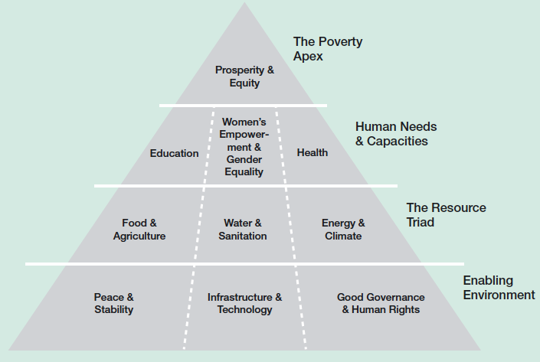
Investment opportunities
impact investing can generate
$1 trillion
Source: Global Compact, UNCTAD World Investment Report 2014.

Slide 6
Science-Policy interface
Policy
Science
Technology
Enterprise
Technology policy should be science based
and enterprise driven

Slide 7
National Innovation System
Ideal
Actual
Policy
Enterprise
Science
Policy
Enterprise
Science
Close linkages within government & between technology users
Need to foster linkages

Slide 8
Types of linkages
Foreign direct investment (joint ventures, licensing agreements and strategic partnerships)
Transnational corporations account for 75% of world R&D
Linkages with technology partners (knowledge networks)
Forward linkages with customers (exports)
Participation in global supply chains
Backward linkages with suppliers (SMEs)

Slide 9
Fostering linkages
Encourage closer link between firms and universities and research institutions
Invest in training, technical education and human resources development
Invest in infrastructure (e.g. EPZs, industrial clusters and science parks)
Provide business support services for SMEs
Entrepreneurship development

Slide 10
Conclusion
SDGs will require significant investment but progress towards the SDGs will generate its own investment
Investments in technology requires investing in people, enabling entrepreneurs and supporting domestic enterprises, particularly SMEs
The Arab region contains a range of economies that can trade and invest more with each other

